Slide 1
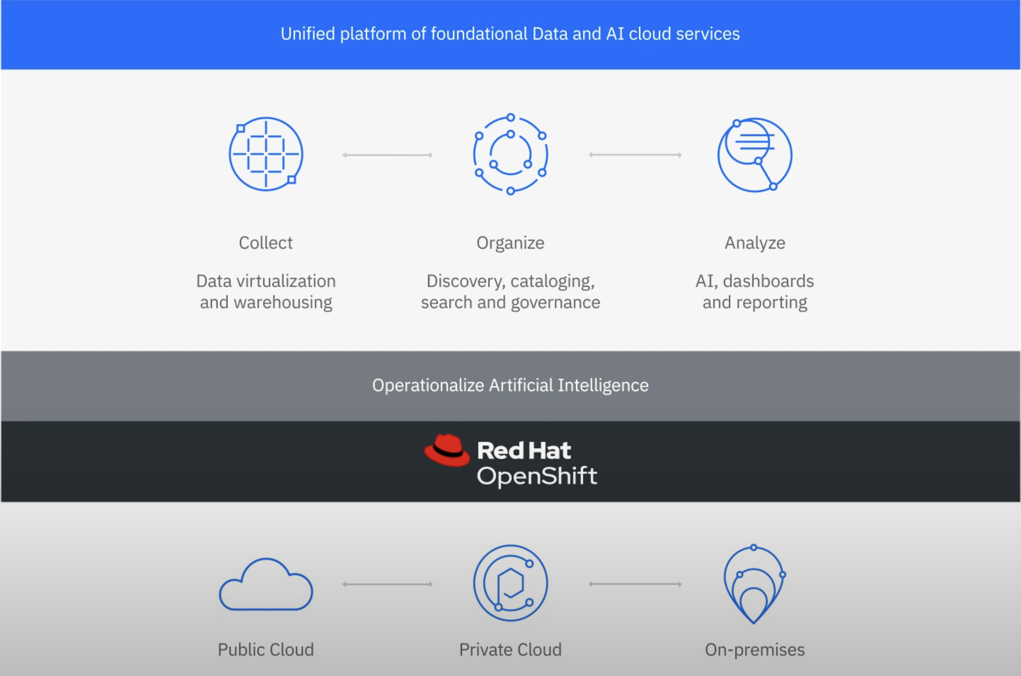
Cloud Pak for Data
Data Integration
Data Governance
AI Governance
Data Science and MLOps

Slide 2

Collect
Organize
Analyze
Infuse
Knowledge Accelerators (business terms) & Industry Accelerators (demonstrators)
3rd Party
3rd Party
Virtual Data Pipeline
3rd Party
Anaconda Repository
3rd Party
Informix
EDB Postgres
Product Master
OpenPages
Watson Knowledge Studio
Watson Speech to Text
Cognos Analytics
Planning Analytics
Db2 Advanced
MongoDB
DataStage
Data Replication
Watson Discovery
Watson Assistant
Db2 Warehouse
Watson Query
Watson Knowledge Catalog
Watson Studio
Jupyter / JupyterLab
RStudio
AutoAI
SPSS Modeler
Watson OpenScale
Db2 Data Gate
Analytics Engine - Spark
Analytics Dashboards
Decision Optimization
Data Refinery
Execution Engine for Apache Hadoop
Data Privacy
Match 360
Watson Machine Learning & Machine Learning Accelerator
Db2 Big SQL
Data Management Console
AI Factsheet
Cloud Pak for Data
Platform Services
Data Source Connections
Authentication, Roles and Authorization
Installation, patching & upgrades
Watson Pipelines
Backup & Restore
Workload Management, Metering, Diagnostics
Extensibility – Add-on Services & Access management
On-premises
Cloud Pak System

Slide 3
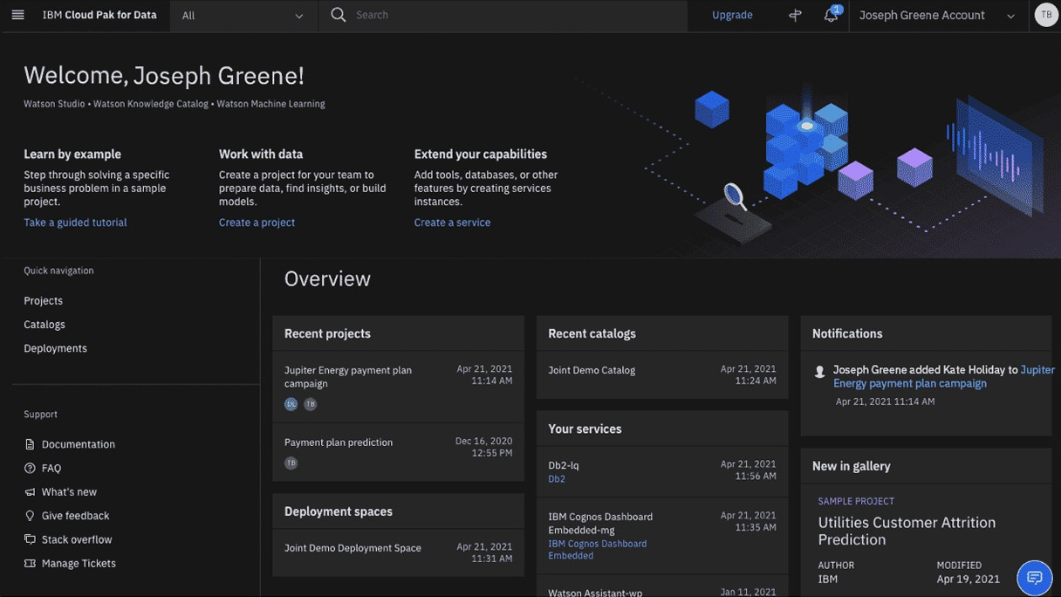
Cloud Pak for Data
Data Search
Data request
Projects
-Data
-Tools

